Slide 1


Conducting an Experimental Design
BY:
Jess Joblin
Dylan Demo
Josh Lapish
Notes:
Dylan

Slide 2
What is experimental design?
Experimental Design: The process of how an experiment is conducted
Why is it important?
Effectively conduct an experiment with the correct type of design
Determining how to answer the research question
Aspects to consider
Types of experimental design
Removing biases and variability
Finding flaws in experiment
We will split up the idea of experimental design into two main steps…
Prepare for experiment
Conduct experiment
Notes:
Dylan
Simply put, experimental design is the process of how you go about performing an experiment. In general, experimental design is important because it allows us to decide how we go about finding significant results. When conducting a study, you may add or remove certain components of your design depending on the research question. Adding multiple of these components can create more complicated (yet useful) designs, but the main components of the majority of experimental designs usually include what we call factors blocks. The factor of an experiment is our variable of interest and the blocks of an experiments are used to get rid of unwanted variability (what we will call nuisance factors). We will go into more detail later about what these components are and how to use them to setup an experiment.
To start off, we will use an example study we conducted on testing the reaction times of individuals based on the type of reaction qu

Slide 3

Preparation
for Experiment
3.) Define your nuisance variables
4.) Choose your type of experiment
5.) List your initial protocol
1.) What question(s) do you want to answer?
2.) What are the elements of your design?
Notes:
Dylan
We will use this format here to explain the steps on how to plan out your own experimental design. Starting with our example study, the general research question we want to answer is how will the type of sound cue affect reaction time. The elements of the design are going to be the factor and blocks. In our example, the factor is the type of sound que and the blocks are our test subjects themselves (we will explain more later). Any nuisance variables that will complement the kind of block in your experiment. The type of experiment, and finally what the initial protocol

Slide 4

01
Defining Your Goal
Notes:
Dylan

Slide 5

What question do you want to answer?
What are you interested in?
What do you want to prove?
What materials do you have access to?
OUR QUESTION:
Is an individual’s reaction time impacted by visual or auditory cues?
Think to yourself…
Notes:
Dylan
In our experiment, we wanted to see if mean reaction times were affected by different methods of stimulus. In particular, we wanted to see if auditory or visual stimuli result in faster mean reaction times among individuals.

Slide 6
02
Defining the Elements of Your Experiment
Notes:
Jess
The next step is defining the main elements of your design, which will now dive into

Slide 7
What elements will your experiment use?
Block
Factor
Level
Arrangement of experimental units into similar groups
An explanatory variable manipulated by the experimenter
Participants
Type of reaction test
Visual
Auditory
Combined
Different values of the factor
Notes:
Jess
There are three crucial elements to define when beginning the development stages of an experiment: blocks, factors, and levels.
A block is the arrangement of experimental units into groups that are similar to one another. In our experiment, we had one block, which were the individual participants. Rather than having 12 people take the visual test, 12 people take the auditory test, and 12 more people take the combined, test, we had 12 of the same participants take all three reaction tests to remove variability. Therefore, our block is the individual participants because they are being reused in the experiment.
Next, a factor is an explanatory variable that is manipulated by the experimenter. In our case, this was the type of reaction test that the participant would participate in.
Within this factor, there were three levels, which are the different values of the factor. In our experiment, these were the three types of reaction tests we ran: the visual, auditory and combined test.

Slide 8
03
Nuisance Variables
Notes:
Dylan

Slide 9
What is a Nuisance Variable?
What Nuisance Variables Did we Have to Consider in Our Experiment?
NUISANCE VARIABLE
Human variability
Order of Reaction Tests
Any potential source of variability that can distort the effects of the conditions in an experiment
Notes:
Dylan
Any potential source of variability other than the conditions being compared. Nuisances can distort the effects of the conditions in the experiment. By using blocking, nuisance variables can be turned into factors of the experiment.

Slide 10
04
Choose Your Experiment
Notes:
Jess
The next step in preparing for an experiment is choosing the type of experiment that is best suited

Slide 11
Types of Experiments
Complete Block Design - CB[1]
Latin Squares - LS[1] LSRM
Randomized Block Design - RBF[1]
Split Plot Repeated Measures - SP/RM[1;1]
Balanced Incomplete Block Design - BIBD
2^{K} Design
1 Factor
1 Block
1 Factor
2 Blocks
1 factor
2 Factors
1 Block
1 Interaction
Similar to CB[1], but with certain adjustments
Used for testing multiple factors
Notes:
Jess
The following are the many types of experiments we can choose from before we perform the experiment. Many of these can get pretty complicated depending on how many elements (factors and blocks) are added to the experiment, and what type of research question you want to answer.
It’s also worth noting the in SPRM or any design that has more than one factor, there is usually what we call an interaction between them, which essentially explains the relationship between the two factors with the response variable
The most simple experiments are the RBF [1] and CB [1]; the latter is what we will be using in our study on reaction times, which involves 1 block and 1 factor.

Slide 12
What Type of Experiment Did We Use?
CB[1]
Remove nuisance variable by blocking
1 Block = Participants
1 Factor = Type of Reaction Test
CB[1]
Complete Block Design
Notes:
Jess
For our study, a complete block design, also known as CB[1], was the most appropriate because we were able to turn the nuisance variable of differing base reaction times among individuals by blocking the participants and having each participant experience each level of the treatment factor. By having each participant experience each level, variability in the overall results was decreased, as opposed to having a different individual for each condition.

Slide 13
05
Design Initial Protocol
Notes:
Josh

Slide 14


Initial Protocol
Step 1
Step 2
Step 3
Step 4
Determine Level of Test
Record Average
Take Random Sample
Participant Performs Reaction Test
Notes:
Josh
When making the initial protocol for the experiment, the main focus is that it includes all the necessary elements. That it is specific enough that anyone else could follow it without any outside information, as well as including how randomization will be implemented within the experiment.
Take a random sample of 10 participants from class rosters.
For each participant, flip a coin to determine whether the participant performs the audio or visual test first. Repeat this process for the next factor level, then have them perform the remaining level.
Have participants perform the first reaction time test 10 times.
Calculate average and record for that participant.
Have each participant perform the second reaction time test 10 times, and record the average for each participant.
Have each participant perform the combined visual and auditory cue reaction time test 10 times and record the average for each participant.

Slide 15
Conducting
Your Experiment
3.) Finalize Protocol
4.) Conduct Experiment and Collect Results
5.) Make a Factor Diagram
1.) Conduct Pilot Study
2.) Reflect on Pilot Study
Notes:
Jess
So as noted previously, we split up this powerpoint into 2 main sections: preparing for the xperiment and conducting our experiment.
For the second half of this presenting, were going to divee into actually conducting our experiment which is composed of 5 main steps

Slide 16
01
Conduct Pilot Study
Notes:
josh

Slide 17
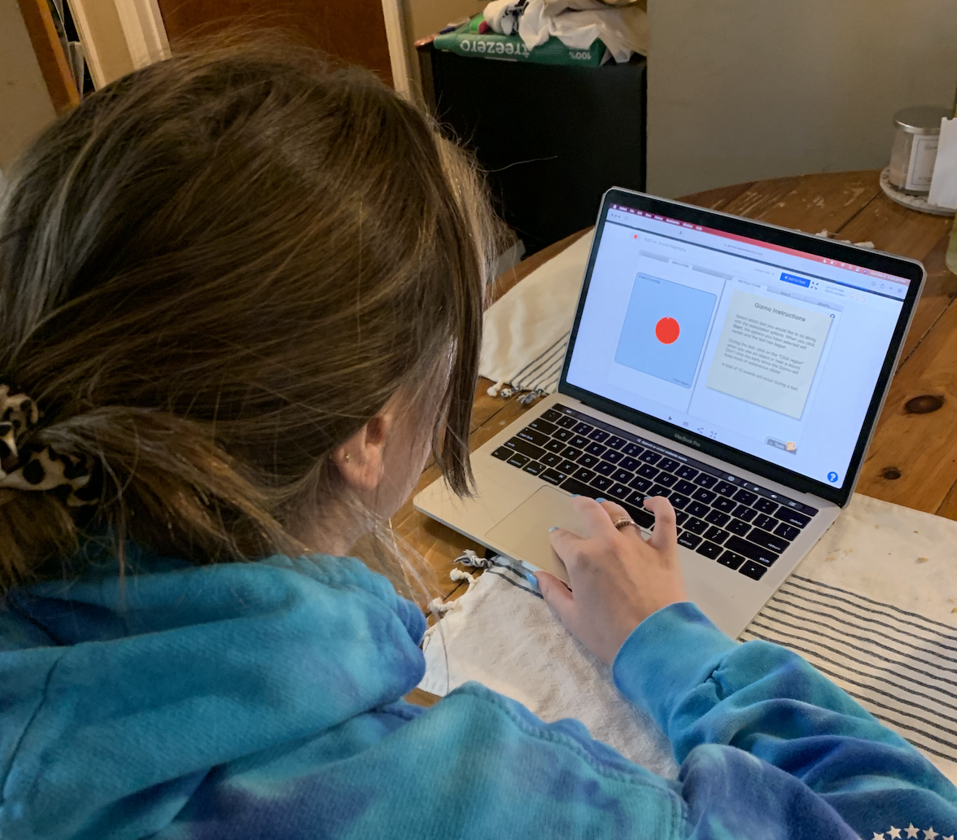


Pilot Study
With a fake set of participants, have them follow the initial protocol and collect the results.
This will allow you to alter any issues you come across
Notes:
Josh
When creating an experiment, running a pilot study (sort of like a test run) is beneficial because it helps to identify any unexpected issues in the initial protocol. In our study in particular, the pilot study revealed that our original method of randomization was not the most effective, and by going through the steps of the experiment to see how it would run, as well helping to further refine the protocol with the addition of specific instructions and environments for the actual experiment so that bias and variability can be reduced.

Slide 18
02
Reflect on Pilot Study
Notes:
Jess
After conducting the pilot study, it is crucial it is crucial to reflect on what went well, as well as aspects of the experiment that will later need to be improved

Slide 19

Human error
Keeping materials constant
Removing possible distractions
Randomizing test order
Where were biases and variability introduced?
What went well in the pilot study that needs to remain the same?
Notes:
Jess
It is important to reflect on potential limitations within your study, as well as consider ways it could be improved in the future. For our specific pilot study, we found that it ran smoothly in terms of collecting results, however, we realized that a lot of bias was introduced because external factors were not standardized. Since we did not use the same laptop for every participant and the experimenting rooms had different noise levels and brightness, there was a lot of variability in our initial results. By taking note of all these flaws in the initial protocol, we were able to have a better and more uniform set of testing conditions later on.
we found that the experiment ran smoothly and that we controlled for variance well through the ways in which we went about randomizing the testing order and having a uniform set of testing conditions. As for limitations,because our sample was Elon students in general there may have been more variability than if we had a sample of individuals of the same gender, age, etc.

Slide 20
03
Finalize Protocol
Notes:
Josh

Slide 21
Finalized Protocol
4. Have the participant enter a room that has a controlled environment
Aspects to control:
Lighting in room
Sound/distractions
Volume and brightness of laptop
5. Have the experimenter read the instructions in a script format
6. Direct the participant to take the test
7. Collect the results
1. Take a convenience sample of 12 college students
2. Randomly assign each participant the order of the treatment tests
Visual, Auditory, Combined
Visual, Combined, Auditory
Auditory, Visual, Combined
Auditory, Combined, Visual
Combined, Visual, Auditory
Combined, Auditory, Visual
3. Ensure the website is pulled on the test to take
Notes:
Josh
After running the pilot study, we finalized the protocol for the experiment. We implemented a new means of randomization, by having each potential order written out and then randomly assigned to participants so that each order was used twice. We also included added instructions for controlling the environment in the testing environment, by using the same computer and same settings for each participant during the experiment. Overall, our final protocol was very specific and intentionally controlled for any potential biases and had an effective method for randomizing the order in which the different levels of the factor were tested.
Take a convenience sample of 12 college students.
Randomly assign each participant the order of the three treatment tests and ensure that three participants are assigned to each of the order categories. This will be done by putting three of each test level orders in a bag and having each participant select one without putting their selection back in the bag. Make sure each participant is informed of their test order.
There are six ways to order the levels, so each of the following will be in the bag two times:
Visual, Auditory, Combined
Visual, Combined, Auditory
Auditory, Visual, Combined
Auditory, Combined, Visual
Combined, Visual, Auditory
Combines, Auditory, Visual
Have the website with the test pulled up on the laptop for the participant to take:
https://gizmos.explorelearning.com/index.cfm?method=cResource.dspView&ResourceID=43
This source will automatically time out after five minutes, so you will need to make an account in order to use this without any issues.
Have the first participant enter an empty classroom with the experimenter and ensure all conditions are accounted for
Aspects to hold constant:
Turn all lights in the room on
Ensure the same laptop is being used with the brightness and volume turned all the way up
Ensure there are no other people in the room to eliminate outside noise and distractions
On the website, use these settings:
Visual test: Sight = “red circle”
Auditory test: Sound = “bell”
Combined test: Sight = “red circle”, Sound = “bell”
The experimenter will read the following instructions to make sure all participants are provided with the same information:
“There are three tests that will be conducted to test your reaction time: visual, auditory, and combined visual and auditory. For each reaction test, there will be 10 attempts that will be averaged. For the visual test click the touchpad in the blue area when the red circle appears. For the auditory test, click the touchpad in the blue area when a bell sound goes off. For the visual and auditory test, click the area when either a red circle appears or the bell sound goes off. This test will randomly switch ques between the red circle and bell; they will not be queued at the same time. Before you begin the first test, place your finger on the keypad to show you are ready.”
Direct the participant to take the test.
They will take a total of three tests in the order they were previously given in the second step.
Collect the results.
In an excel sheet, track the participant’s name along with the order in which they took the three tests
Record the average score, standard deviation, and ten reaction times for each of the three tests.

Slide 22
04
Conduct Experiment & Collect Results
Notes:
Dylan

Slide 23
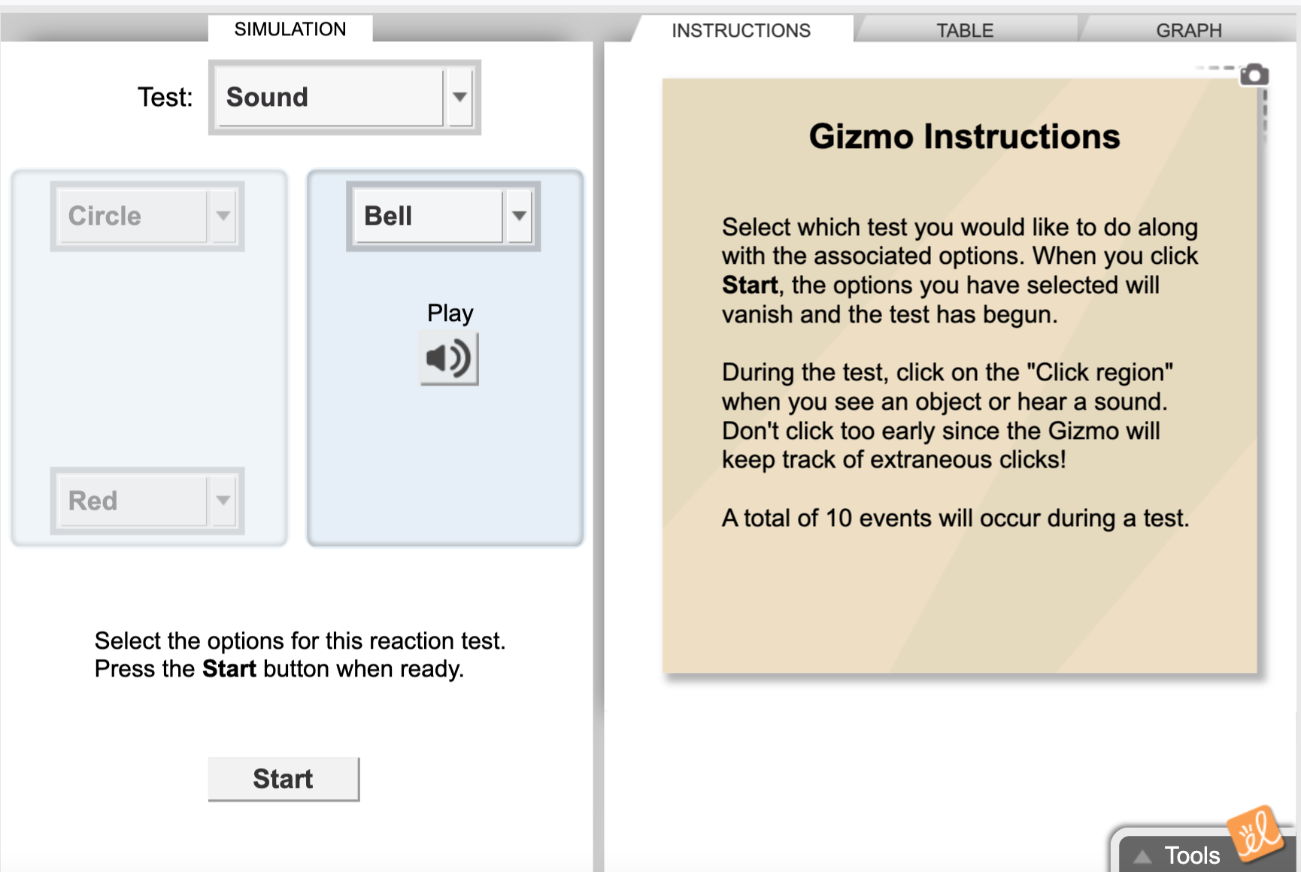
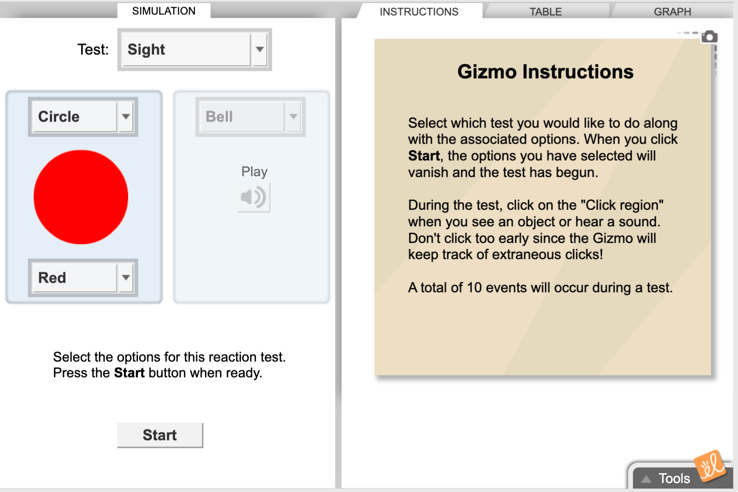
Conduct Final Experiment
Based on pros and cons of initial protocol, conduct the experiment with your finalized list of participants
Collect results in an Excel sheet
Load data into statistical software to analyze results
Notes:
Dylan
We wont get too into detail on looking into the actual results of the experiment, like analyzing hypotheses, but essentially after correcting the mistakes in the pilot study, make sure everything in the final protocol is up to date.

Slide 24
05
Factor Diagram
Notes:
Jess
To conclude, our last step in conducting an experiment is making a factor diagram, which may be a new term to a lot of people.

Slide 25
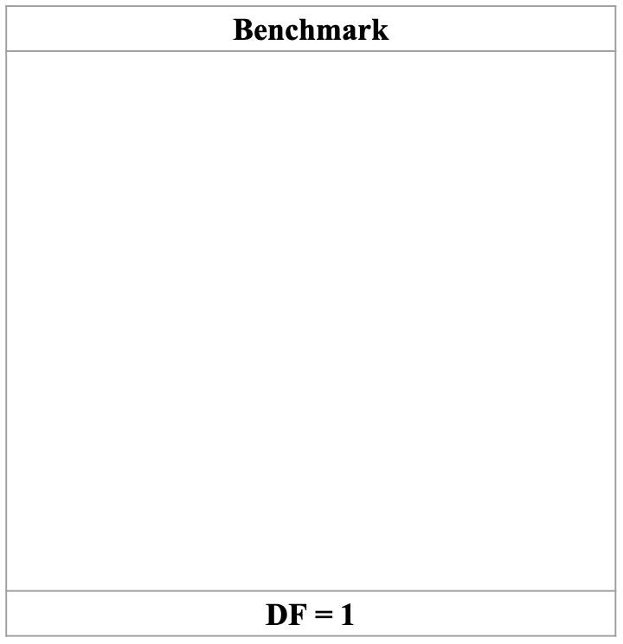
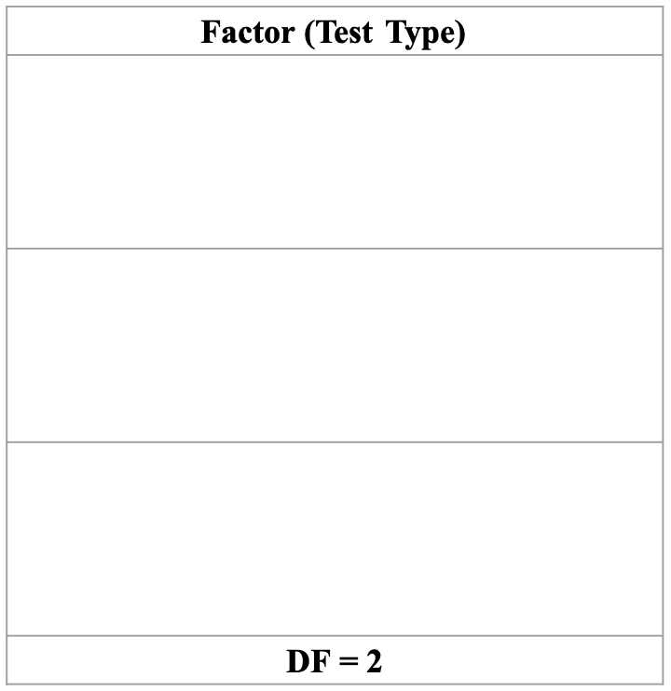
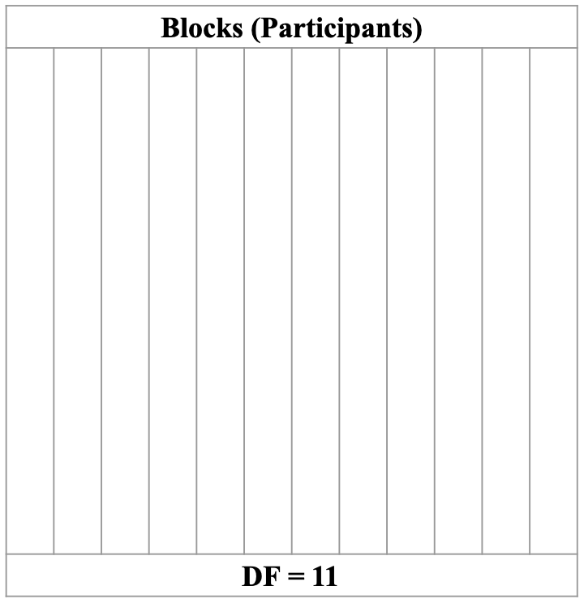
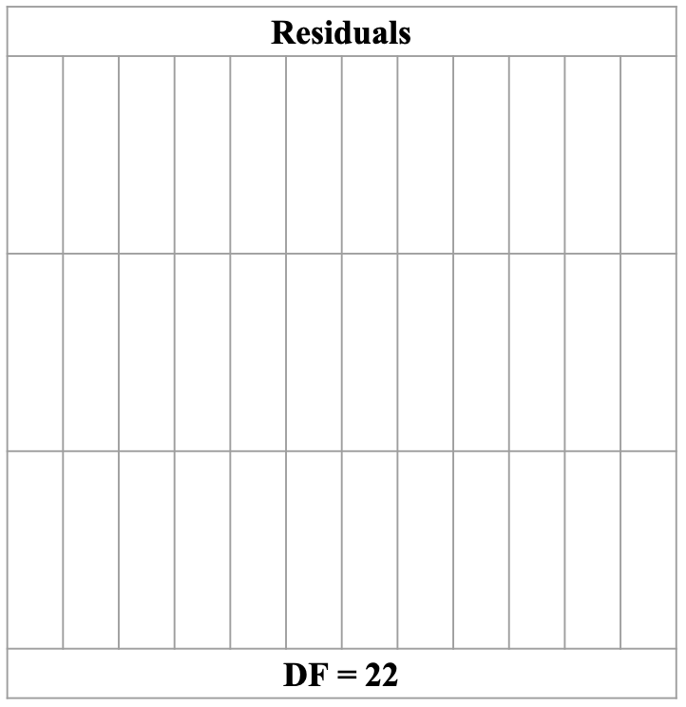
Factor Diagram
Benchmark
Factor
Blocks
Residuals
Notes:
Jess
Generally speaking, factor diagrams are used to measure variability across multiple elements of our experiment. After collecting all of the necessary averages (for our overall grand mean, factor, and blocks) we can visually assess where our differences in variability are by subtracting them from the grand mean. Simply stated, if a a number in one of the spaces in the factor diagram is negative, it is below average, and if it is positive, it is above average.
A factor diagram isn’t necessarily apart of the “conducting experiment” section of experimental design, but we wanted to note it because it breaks down how we will later assess our findings. these numbers listed in the factor diagrams will later be used for variability calculations in the ANOVA table.

Slide 26


Thank you!
Notes:
Jess —
So that was our presentation explaining an experimental design! We hope you were able to learn something new! Thank you!

